Slide 1


FULL STACK WEB DEVELOPMENT WITH DJANGO
Lecture 20

Slide 2

Today’s Agenda
Developing Our Django App
Using include Tag
Example

Slide 3
The include Tag
To understand working of {% include %} tag , let’s make some modification in our previous code where we had three apps mainsite, courses and trainers .
Within mainsite we had three html templates called base.html, home.html and about.html.
Now suppose in the home.html page we need to show a list of popular courses

Slide 4
The include Tag
One way to do this is to directly add the HTML code for generating popular courses list in the home.html template as shown below:
{% block listitems %}
<p>Welcome To my SCA home page</p>
<h3>Our Popular Courses</h3>
<ul>
<li>Django</li>
<li>Adv Java</li>
<li>Core Java</li>
<li>Python</li>
<li>JavaScript</li>
</ul>
{% endblock listitems %}

Slide 5
The include Tag
But this code might need to be included in some other pages also like a page of favourite courses.
So Django recommends to create a separate .html page containing the popular courses list and then include that .html page in our home page using the {% include %} tag

Slide 6
The include Tag
The include tag
The include tag allows us to include the contents of a template inside another template.
Syntax:
{% include template_name %}
The template_name could be a string or a variable.

Slide 7
The include Tag
To use the {% include %} tag in our example we need to make two modifications:
Create a separate .html page containing popular course list . We will name this page as popular.html.
Then in the home.html page we can include the popular.html page by using the {% include %} tag

Slide 8
The mainsite/popular.html Template
<h3>Our Popular Courses</h3>
<ul>
<li>Django</li>
<li>Adv Java</li>
<li>Core Java</li>
<li>Python</li>
<li>JavaScript</li>
</ul>

Slide 9
Including popular.html
To include popular.html page in the home.html page we will use the {% include %} tag as follows:
{% block listitems %}
<p>Welcome To my SCA home page</p>
{% include 'mainsite/popular.html' %}
{% endblock listitems %}

Slide 10
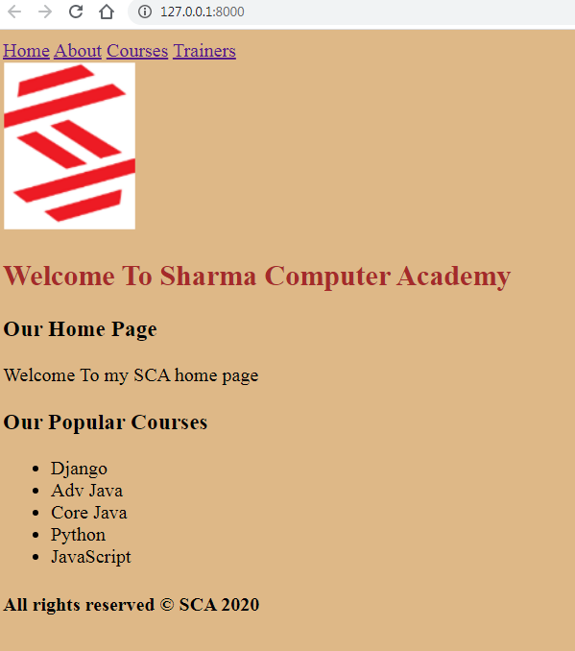
Output

Slide 11
Passing Data To include Tag
Django allows us to pass some dynamic data to the include tag .
This data can then be used in the template file which we are including.
To do this we use the following syntax:
{% include template_name with <some_name>=‘<some_value>’ %}
Here with is a DTL tag which allows us to create a variable as and pass it to the included html page.

Slide 12
Passing Data To include Tag
{% block listitems%}
<p>Welcome To my SCA home page</p>
{% include 'mainsite/popular.html' with course1='Hibernate‘ %}
{% endblock listitems %}

Slide 13
Using Data In Template
<h3>Our Popular Courses</h3>
<ul>
<li>Django</li>
<li>Adv Java</li>
<li>Core Java</li>
<li>Python</li>
<li>JavaScript</li>
<li>{{ course1 }}</li>
</ul>

Slide 14
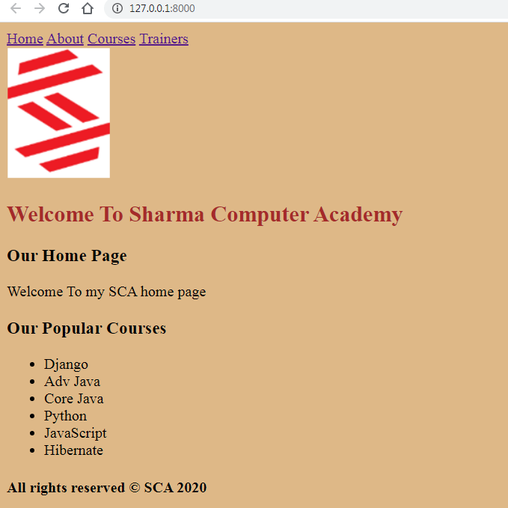
Output

Slide 15
Passing Multiple Data
Django allows us to pass multiple data also to the included file and we do this as follows:
{% block listitems%}
<p>Welcome To my SCA home page</p>
{% include 'mainsite/popular.html' with course1='Hibernate‘ course2=‘Spring’ %}
{% endblock listitems %}

Slide 16
Using Mutiple Data
<h3>Our Popular Courses</h3>
<ul>
<li>Django</li>
<li>Adv Java</li>
<li>Core Java</li>
<li>Python</li>
<li>JavaScript</li>
<li>{{ course1 }}</li>
<li>{{ course2 }}</li>
</ul>

Slide 17

Output

